Slide 1
Financial Discipline
Session 4
Where our finance is spent in India

Slide 2
How the government wastes Rs20,000 crores every year – India Today
As much as 20 per cent of the Rs 100,000 crore that the Central and state governments spend in a year may be going waste. “ INDIA TODAY” Magazine looked at the problem and spelled out 12 laws that govern the colossal waste involved in government spending.
The sums are staggering. Every third rupee spent in the country is spent by some government department or the other. That's Rs 100,000 crore a year. And every fifth rupee out of that goes waste: Rs 20,000 crore a year, Rs 4 lakh down the drain every minute.
Example : Government decided three years ago that it should promote community singing. So tape recorders and recorded tapes were supplied to schools. The objective: make community singing a mass movement. The Plan budget: Rs 25 lakh!!!! ….similarly Rs 30 lakh spent on promoting scientific interest in youth, or Rs 90 lakh for promoting national integration, or Rs 6 crore spent on administrative tribunals that are nonfunctional, and so on…….
India Budget
Rs. 21,47,000 Crores
India Population
(135 Crores)
Average Amount per person
Rs. 15,900

Slide 3
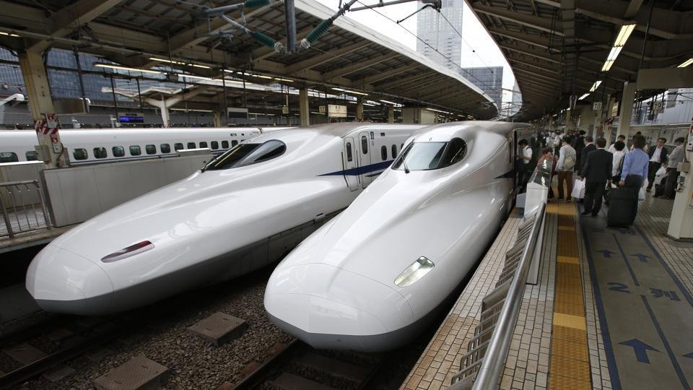
Examples in Public Sector
1. The central government spent Rs. 100,000 crore to build a bullet train between Mumbai and Ahmedabad.
Read more at: https://www.indiatoday.in/india/story/bids-invited-for-india-s-first-undersea-tunnel-for-bullet-train-project-1509882-2019-04-25
4.7% of India Budget
Budget Money of 629 Lac people

Slide 4
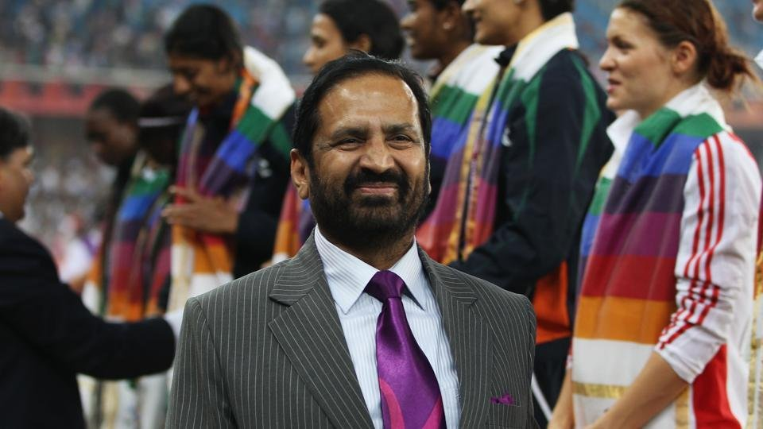
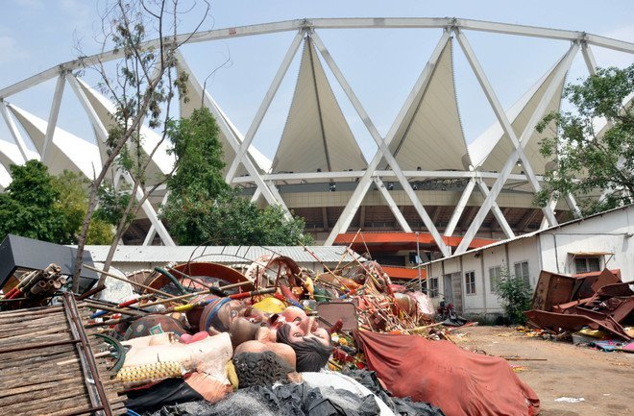
Few Examples in Public Sector
2. Commonwealth Games India - Rs.70,608 Crores)
The short term injection of tourism into the economy wasn't nearly enough to outweigh the economic disruption and displacement caused by this colossal fail of an event. One of the worst and most costly decisions our country ever made. Not to mention those ugly clothes and bags.
Read more at: https://www.indiatoday.in/sports/commonwealth-games-2010/story/games-makeover-is-a-rs-66550-cr-bomb-81012-2010-08-27
3.3% of India Budget
Budget Money of 444 Lac people

Slide 5
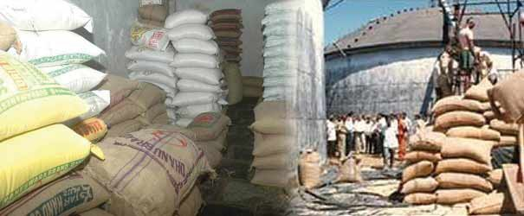
Few Examples in Public Sector
3. Uttar Pradesh Food Grain Scam - Rs.38,500 Crores
The scam, which happened right under the nose of Mulayam Singh, resulted in food grain worth billions, meant for the poor as welfare, being sold into the open market.
Farmers, workers, children, all starved, while the food was hoarded and smuggled to make the rich richer (and fatter).
Read more at: https://www.ndtv.com/india-news/uttar-pradesh-government-admits-rs-30-crore-worth-subsidized-grain-meant-for-the-poor-has-been-diver-1908823
1.8% of India Budget
Budget Money of 242 Lac people

Slide 6
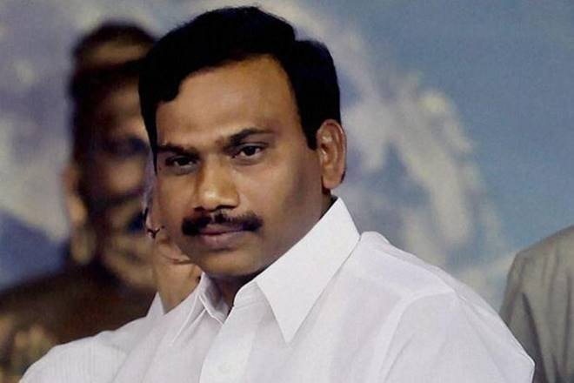
Few Examples in Public Sector
4. The 2G spectrum case was a Rs 30,000 crores alleged scam by the politicians and government officials under the United Progressive Alliance (Congress) coalition government in India.
The Union Government of that time was accused of undercharging mobile telephone companies for frequency allocation licenses, which they used to create 2G spectrum subscriptions for cell phones.
Read more at: https://economictimes.indiatimes.com/news/politics-and-nation/a-raja-kanimozhi-acquitted-in-2g-scam-case/articleshow/62189376.cms
1.4% of India Budget
Budget Money of 189 Lac people

Slide 7
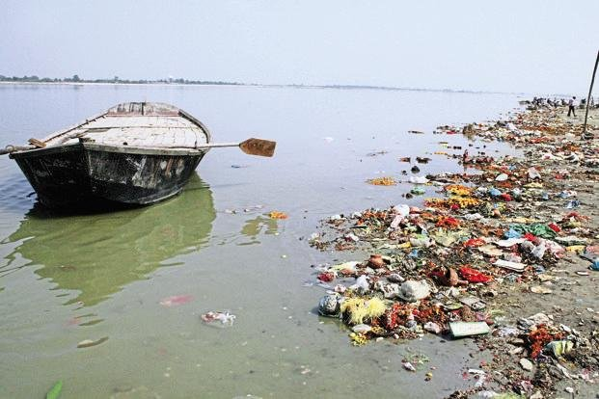
Few Examples in Public Sector
5. Rs 7,000 crore spent in 2 years to clean Ganga - "Even after spending Rs 7304.64 crores upto March 2017, by the Central Government, State Government and local authorities of the State of UP, the status of river Ganga has not improved in terms of quality. It is waste of public money."
The NGT blamed the absence of a long-term plan and the lack of pollution abatement works for hampering efforts to clean it up.
Read more at: https://economictimes.indiatimes.com/news/politics-and-nation/rs-7000-cr-spent-on-ganga-in-2-yrs-without-improvement-ngt/articleshow/59584914.cms
0.3% of India Budget
Budget Money of 44 Lac people

Slide 8
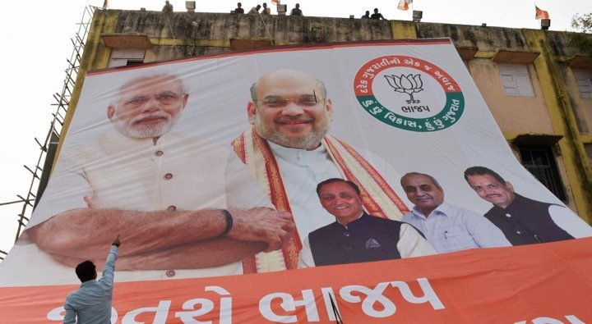
Few Examples in Public Sector
6. The Modi government spent Rs 3,755 crore on ads and publicity.
Read more at: https://www.ndtv.com/india-news/modi-government-spent-rs-3-755-crore-on-advertisements-rti-1785471
0.2% of India Budget
Budget Money of 24 Lac people

Slide 9
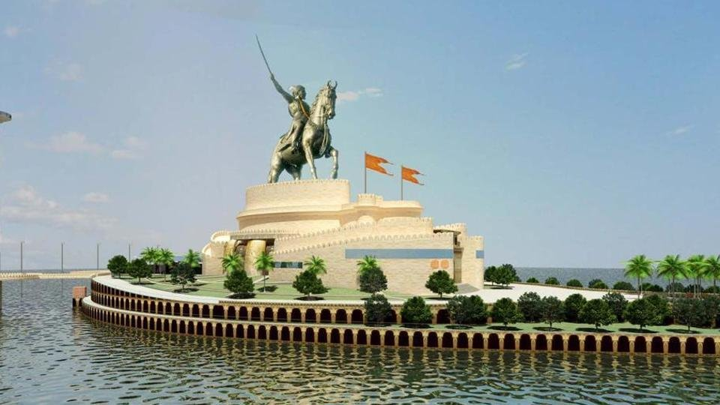
Few Examples in Public Sector
7. The Maharashtra government will spend Rs. 3600 crore on a Shivaji statue in Mumbai.
The construction of the statue would cost Rs 2581 crore, while Rs 309.72 crore would be the GST on the amount. Rs 236 crore would be spent on security infrastructure, Rs 45 crore for permanent water and electricity supply at the completed statue, the GR said.
Read more at: https://www.indiatoday.in/india/story/shivaji-statue-to-cost-maharashtra-rs-3643-78-crore-1416064-2018-12-24
0.2% of India Budget
Budget Money of 23 Lac people

Slide 10
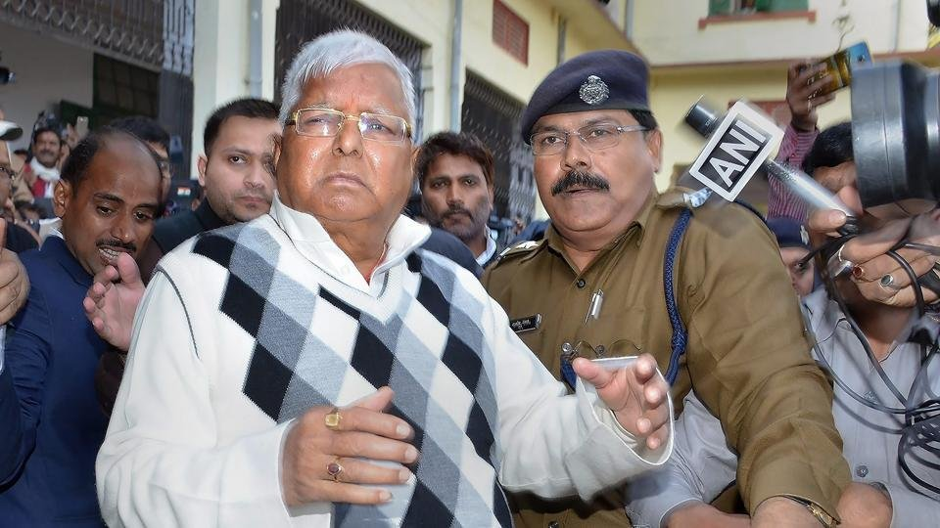
Few Examples in Public Sector
8. The Fodder Scam - Rs.940 Crores/-
The Fodder Scam was a corruption scandal that involved the embezzlement of about ₹9.4 billion from the government treasury of the eastern Indian state of Bihar.
Among those implicated in the theft and arrested were then Chief Minister of Bihar, Lalu Prasad Yadav, as well as former Chief Minister, Jagannath Mishra.[
There is also allegation on Dr. Dineshwar Prasad Sharma of receiving 300 crore and 60 lakh Rupees, respectively, from S. N. Sinha.
On 23 December, 2017 Lalu Prasad Yadav was convicted by a special CBI court while Jagannath Misra was acquitted.
Read more at: https://economictimes.indiatimes.com/news/politics-and-nation/fodder-scam-sc-seeks-cbi-response-on-lalu-yadavs-bail-plea/articleshow/68423712.cms
Budget Money of 6 Lac people

Slide 11
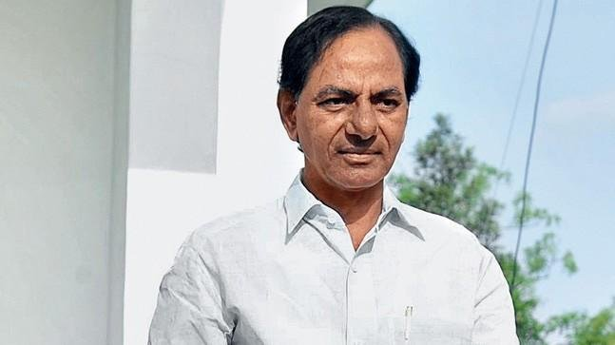
Few Examples in Public Sector
10. Telangana government spent more than Rs. 300 crore making vaastu compliant buildings in Hyderabad.
Telangana Chief Minister KC Rao recently ordered the restructuring of different government complexes because they were not constructed keeping correct 'vaastu' in mind.
Apparently, even Andhra Pradesh Chief Minister Chandrababu Naidu believes in these ridiculous and regressive practises, which cost the taxpayers hundreds of crores.
Read more at: https://www.hindustantimes.com/india-news/braving-protests-and-cost-concerns-kcr-s-vaastu-based-office-closer-to-reality/story-leok7pj4TnZqyCyKyPd6AO.html
Budget Money of 2 Lac people

Slide 12
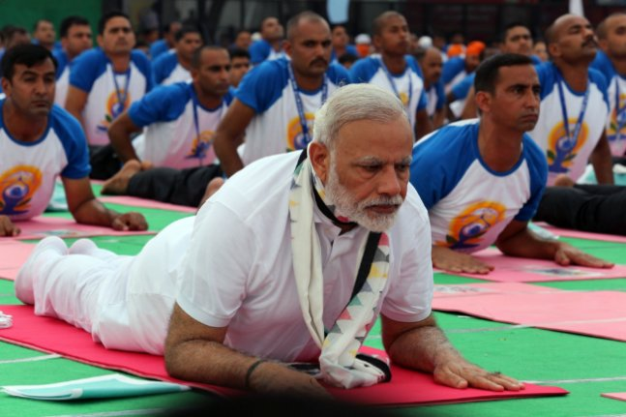
Few Examples in Public Sector
11. The central government spent Rs. 15.87 crore on SMSes on Yoga Day.
Read more at: http://www.firstpost.com/india/hardselling-mann-ki-baat-yoga-day-rti-queries-reveal-modi-govt-spent-rs-24-cr-ads-2379740.html
Budget Money of 10,000 people

Slide 13
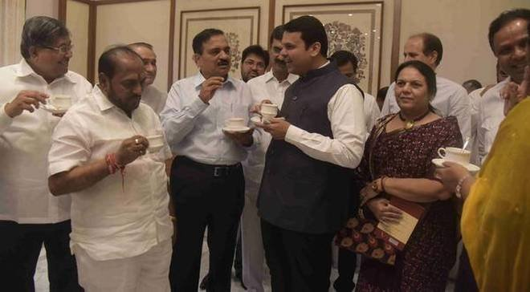
Few Examples in Public Sector
12. Maharashtra CMO spent Rs 3.4 crore on tea in 2017-2018. That's 18,500 cups per day.
Read more at: https://zeenews.india.com/maharashtra/18500-cups-of-tea-per-day-after-rats-congress-alleges-tea-scam-in-maharashtra-2094437.html
Budget Money of 2,140 people

Slide 14
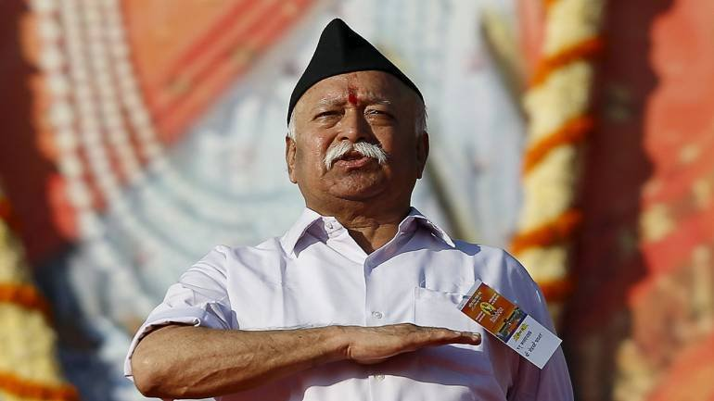
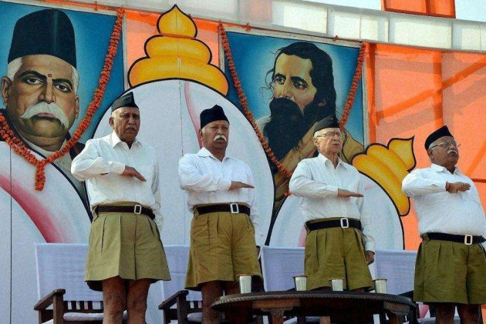
Few Examples in Public Sector
13. The central government spent Rs 1.37 crore of taxpayers' money for repair work at the RSS headquarters in Nagpur.
Read more at: https://www.scoopwhoop.com/times-india-public-funds-were-misused/
Budget Money of 860 people

Slide 15
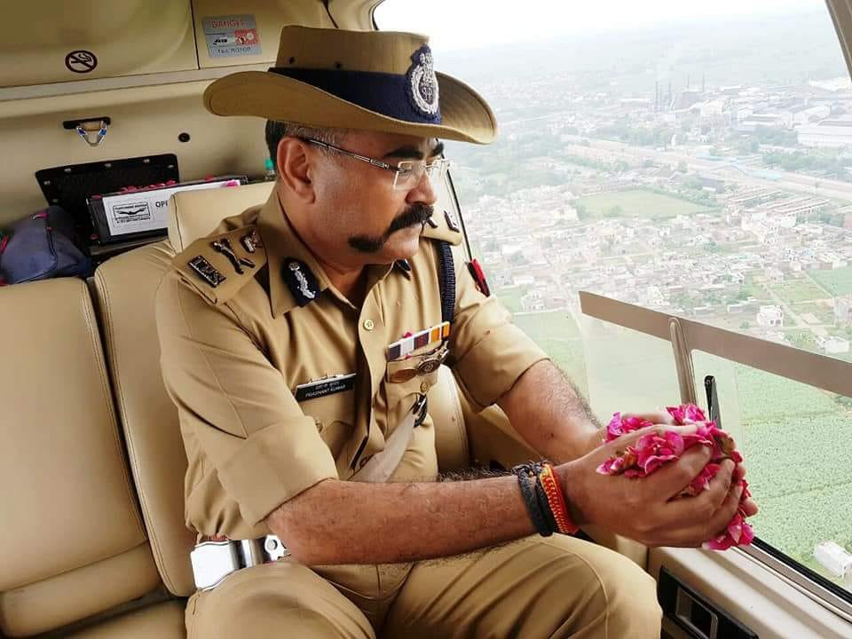
Few Examples in Public Sector
14. NEW DELHI: Uttar Pradesh government spent over Rs 14 Lakh for hiring the chopper from which senior police officers including Additional DGP were seen showering rose petals on kanwar pilgrims in Meerut and adjoining districts. Read more at: //economictimes.indiatimes.com/articleshow/65336216.cms?from=mdr&utm_source=contentofinterest&utm_medium=text&utm_campaign=cppst
Budget Money of 88 people

Slide 16
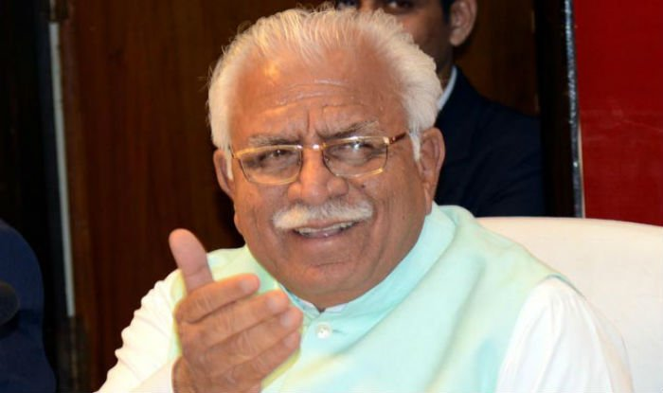
Few Examples in Public Sector
15. The Haryana government spent nearly Rs 3.8 lakh on buying just 10 copies of Bhagvad Gita during the International Gita Mahotsav.
The state also paid Rs 15 lakh to BJP MP and Bollywood star and Rs 10 lakh to Delhi BJP president and actor for their performances at the event! Read more at: http://timesofindia.indiatimes.com/articleshow/62423525.cms?utm_source=contentofinterest&utm_medium=text&utm_campaign=cppst
Budget Money of 24 people

Slide 17
Instead ….
Let's see what else they could have done instead of spending that money.
Feed the hungry kids – 20 Crore Children sleep hungry
Cloth the poor
Housing for many – 20 Lac people are homeless
Education for building the nation – 35 Crore Indians are illiterate
Provide electricity to villages - only 1,417 of India’s 18,452 villages have 100% household connectivity - 7.3% of the total
Make sure that no kid dies from the lack of oxygen again - 2.4 million Indians die of treatable conditions every year
…. among other things!

Slide 18
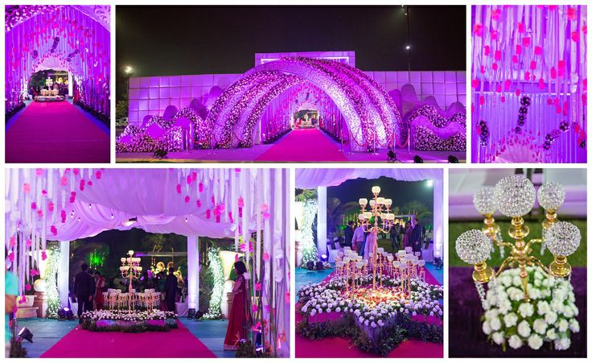
Private Sector - Money spent on waste – 15 ways
1. WEDDING!
People work hard for nearly 30 years and spend 75% of the savings on their daughter’s wedding!

Slide 19
Wedding Industry
Marriage — Even the kings in ancient time do not waste that much money as it is wasted now. Marriage is becoming more of business deal. Dowry is another showoff. If girl parents want to give dowry, instead use the money to plant trees, India has lot of pollution.
In Economics, Marriages (Weddings) are the biggest “unproductive expenses” and most of the poor people in India suffer debts because of this “expense.” If the person can afford such expenses then there's no problem but when you use your lifetime earnings on marriages rather than using it for your smaller child's education then it's not done.
The wedding industry in India is flourishing and statistics corroborate the fact. Currently, the industry is over Rs 100,000 crore and is growing at 25-30% annually. The estimated cost of a wedding with no expenses spared could be between Rs 5 lakh to Rs 5 crore, in India. A person, in India, spends one fifth of the wealth accumulated in a lifetime on a wedding ceremony.

Slide 20
Wedding Gift can be different
Still, there are people who understand the need to allocate monetary resources to better reasons:
Here is an example of a father who used his daughter's wedding's money for a great cause:
Maharashtra-resident Ajay Munot built 90
houses for the homeless worth Rs 7 million to 8 million (between $103,000 to $118,000) from the money he had saved for a lavish wedding for his daughter. Both bride and groom supported the decision, reports the Indian Express. The bride saw it as "the biggest gift for her wedding."

Slide 21
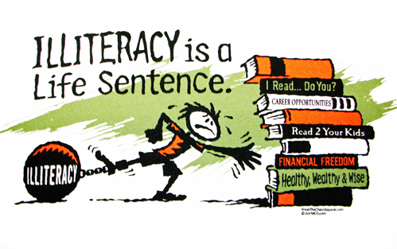
Education Industry
Economic Survey: Government spending on education less than 3 per cent of GDP
Six years ago, that is in 2012-13, education expenditure was 3.1% of the GDP. It fell in 2014-15 to 2.8% and registered a further drop to 2.4% in 2015-16. Although, there have been some signs of recovery since 2016-17 (2.6%)

Slide 22
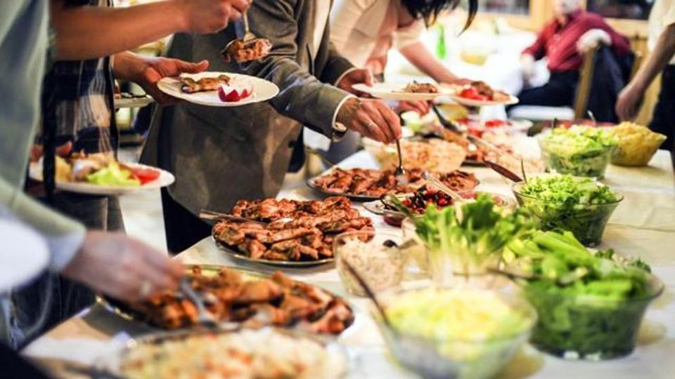
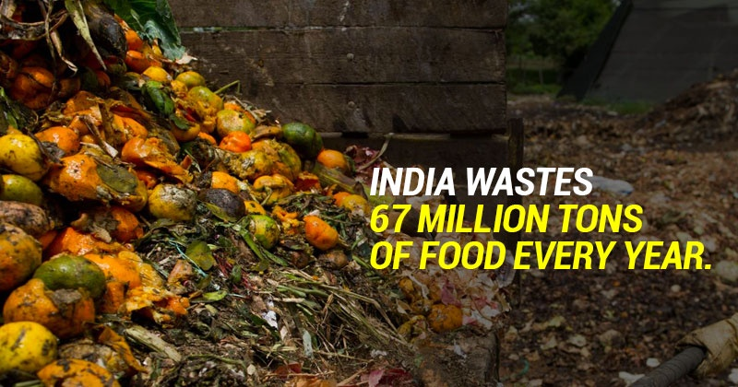
Wastage of Money in India Expensive Lunch/Dinner buffet!
Parties there are hundreds of dishes with a number of cuisines.
Many people hardly eat a few items from there which is not worth the money spent on the buffet.
It’s not only the money that goes into it but also the food that is wasted at the end of the day.
One only wants to have a good dinner to fulfill his appetite & taste.
Spending on too many dishes just adds to wastage of wealth as well as resources.

Slide 23
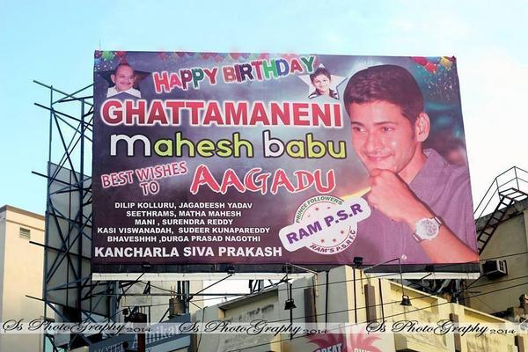
Advertisement Industry
Banners and hoardings - advertisements
Banners and hoardings for almost anything like “25th Wedding Anniversary”, “Happy Birthday”, “Happy Diwali” are not only waste of money but are annoying too!

Slide 24
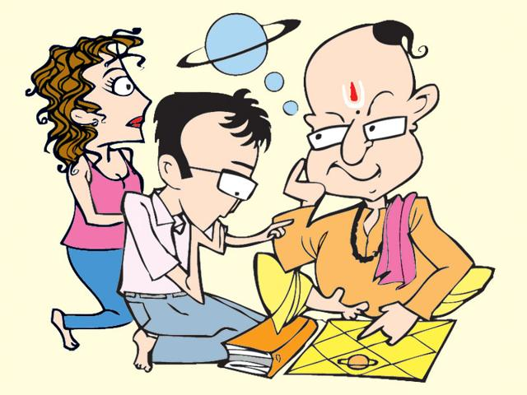

Astrology Industry
Money spent to hear a few good (=fake) words from astrologers

Slide 25
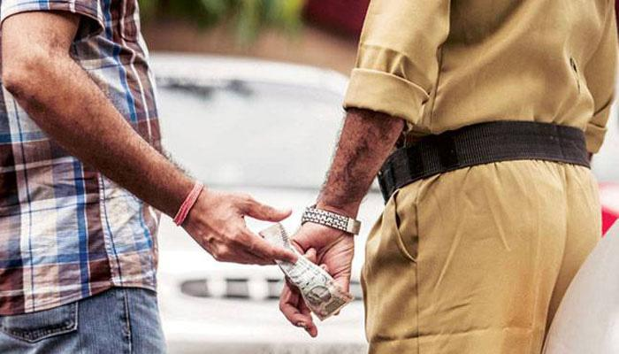
Bribery Industry
Sectors perceived to be most vulnerable to corruption:
Infrastructure & real estate (85%)
Metals & mining (76%)
Aerospace & defense (64%)
Power & utilities sectors (51%)
Corruption has been a major poll plank in the country for decades. All election winning parties have promised to eradicate corruption in both parliamentary and assembly polls.
But a survey has shown that bribes are still the most efficient means to get work done in government offices with 56 per cent people participating in the survey admitting to have paid a bribe in the past one year to get their work done.

Slide 26
Corruption
Corruption has been a pervasive problem in India.^{[375]} A 2005 study by Transparency International (TI) found that more than half of those surveyed had first-hand experience of paying a bribe or peddling influence to get a job done in a public office in the previous year.^{[376]} A follow-up study in 2008 found this rate to be 40 percent.^{[377]} In 2011, TI ranked India at 95th place amongst 183 countries in perceived levels of public sector corruption.^{[378]} By 2016, India saw a reduction in corruption and its ranking improved to 79th place.^{[379]}
In 1996, red tape, bureaucracy and the Licence Raj were suggested as a cause for the institutionalised corruption and inefficiency.[

Slide 27
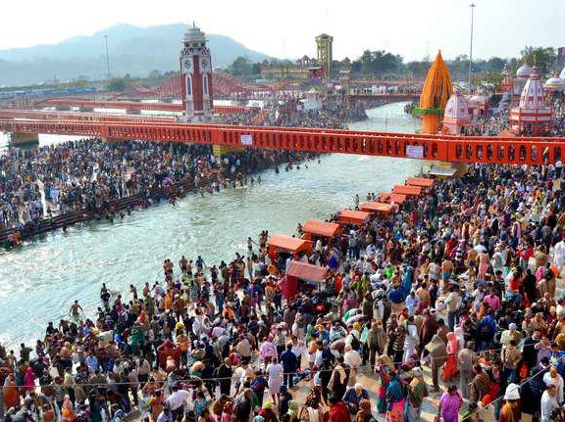
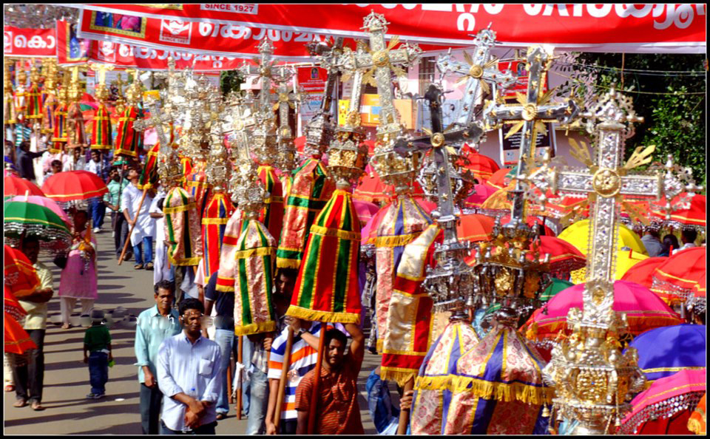
Melas & Festivals!
Kumbh Mela Allahabad
At Prayagraj, alongside thousands of pilgrims and sadhus, entrepreneurs are thronging the sacred ground.
Rs 4,200 crore is pumped by the govt both Central & UP in 2019
Popular Church Festivals
Thousands of Christians are on the streets in the name of religion.
Each Festival will mean expenses above 1 crore

Slide 28
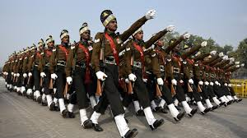

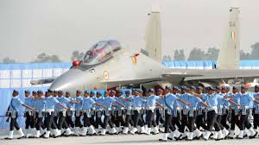
Defence Department of India
Rs 24,42,213 crore. Out of this, Rs 2,95,511.41 crore has been earmarked for defence. “This accounts for 12.10 per cent of the total central government expenditure for the year 2018-19,” the defence ministry said today.

Slide 29
Protection of Govt officials
SPG category – Strength of security detail is Classified (only provided to the current and former Prime Ministers of India and their immediate family members.)
Z+ category has a security cover of 55 personnel [Including 10+ NSG Commando] + [Police Personnel]
Armed with Heckler & Koch MP5 submachine guns and modern communication equipment
Each member of the team is adept in martial arts and unarmed combat skills.
Currently 17 VIPs are provided with such protection
Z category has a security cover of 22 personnel [Including 4 or 5 NSG Commando] + [Police Personnel]
The 'Z' category entails security cover by the Delhi police or the ITBP or CRPF personnel and one escort car.
Currently 433 VIPs are provided with such protection
Y category has a security cover of 11 personnel [Including 1 or 2 Commando] + [Police Personnel]
The 'Y' category encompasses two personal security officers (PSOs)
X category has a security cover of 2 personnel [No Commando, Only Armed Police Personnel].
The 'X' category has one PSO.

Slide 30
Protection of Govt officials
Z security
Security cost around from 7 lakhs to 25 lakhs and it can be varied according to number of security commandos.
total of around 450 VIP's in India gets the high security
SPG Security
Rs 386 crores Annual Budget
Rs. 1 crore per day
In some cases being placed in a category is viewed as a status symbol by politicians, and many use their clout to secure a Z+ security cover. This is criticized often by media as a waste of taxpayer's money. Former Home Minister P. Chidambaram phased out the use of the NSG for VIP protection in all but the most serious cases. Nevertheless, controversies arose as many politicians remained under Z+ cover while many bureaucrats were moved down to Y.

Slide 31
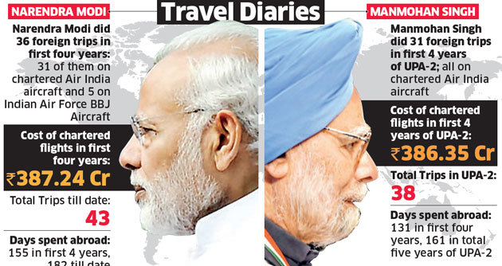
Foreign Travel Industry
Mar 21, 2016 - NEW DELHI: The foreign trips of Prime Minister Narendra Modi and his Cabinet colleagues cost the exchequer Rs 567 crore in the last financial year (2015-16), an increase of more than 80% from the previous year, budget documents show.

Slide 32
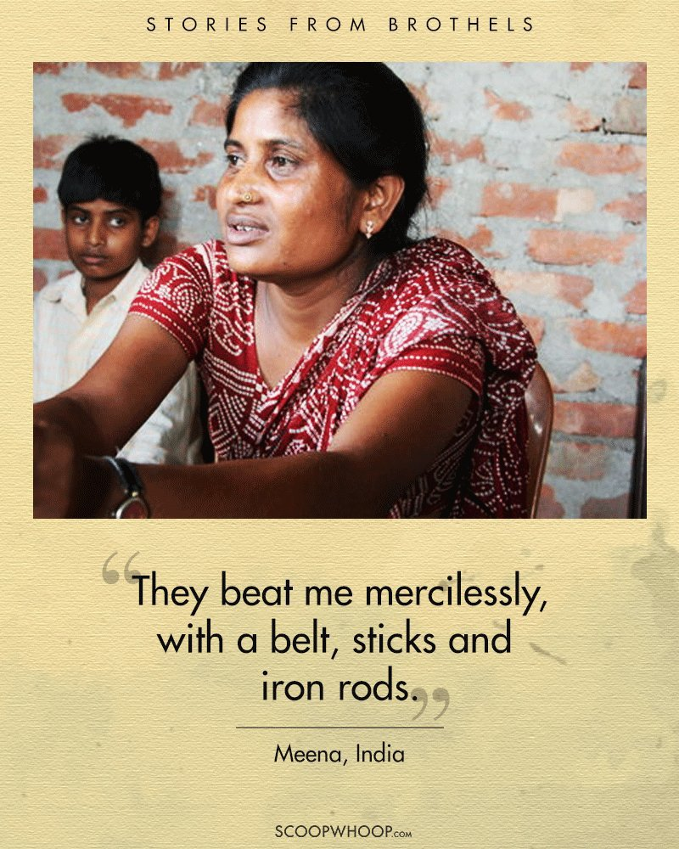
Prostitution Industry in India
Business of Rs.56,000 Crore a year
more then two million prostitutes and 275,000 brothels.

Slide 33

Industry of Religion
Wealthy Hindu temples such as this one are repositories for much of the $1 trillion worth of privately held gold in India — about 22,000 tons, according to an estimate from the World Gold Council. Apr 21, 2015
Padmanabhaswamy Temple, Kerala. The richest temple in the country, the shrine of Padmanabhaswamy possesses wealth of around $20 billion in six vaults of Gold. The Golden idol of Mahavishnu, found in this temple worth Rs. 500 Crore.
In a strange reversal of developments from the West, where religious institutions have seen a decline in income while people have become richer, in India, the gods have become richer while the poor have become poorer.
The richest of all the temples in India, the Padmanabhaswamy temple, is estimated to have around $20 billion. The 2nd richest temple, that of Venkateswara at Tirupati, is visited by approximately 60,000 visitors who donate around Rs 650 crore every year

Slide 34
Industry of Religion
Ganeshotsav insurance cover sought by Ganpati mandals , while the ordinary man on the street has no insurance cover at all
The richest mandal, GSB Seva Mandal at King’s Circle, has purchased insurance cover worth Rs 300 crore due to the 15 kg silver mandap which now houses the Lord, who is adorned with 68 kg of gold and 315 kg of silver.
The organisers handling Lalbaugcha Raja have not only insured their own pandal for Rs 51 crore by paying a premium of Rs 13.2 lakh, but also covered immersion processions across Mumbai.
During dasara Mysore spent nearly 1Cr in decorating Mysore city for 10 days. On the same days there are 4 to 5 hr power cut in residential areas.

Slide 35
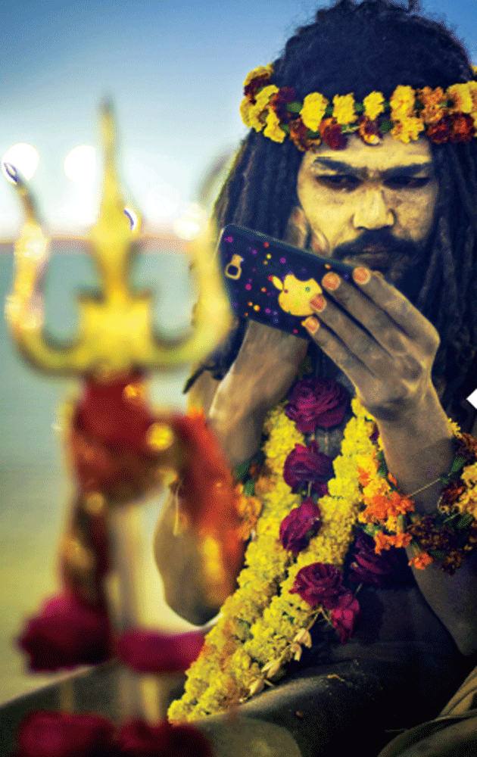
Industry of Religion
The Kumbh Mela has become a place for many Fake Sadhus to make BIG money

Slide 36
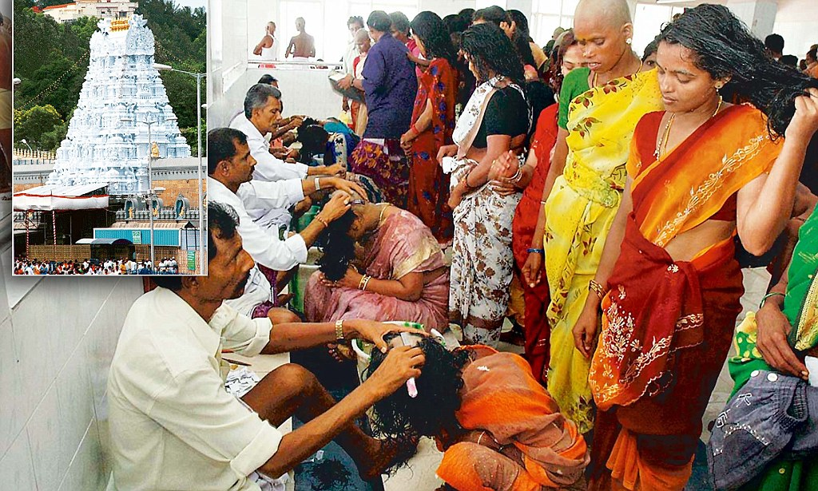
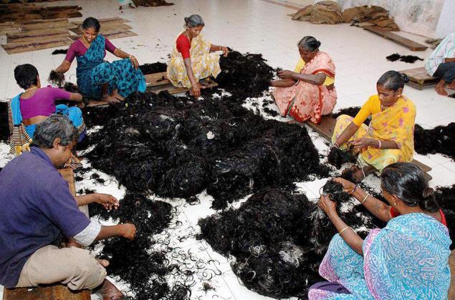
Industry of Religion
Tirumala Tirupati Devasthanams(TTD), the trust that manages the famous hill shrine of Lord Venkateswara temple, is planning to float global tenders for the sale of hair, targeting a revenue of over Rs. 230 crore!..
Hair-raising Rs 230 cr is what Lord Venkateswara Temple, the richest in the world, is targeting as revenue for selling devotees hair
Trustworthy Rs 1,925 cr Tirupathy Temple has been approved by Tirumala Tirupati Devasthanams, the trust that manages Lord Venkateswara Temple, as budget for fiscal 2008-09

Slide 37
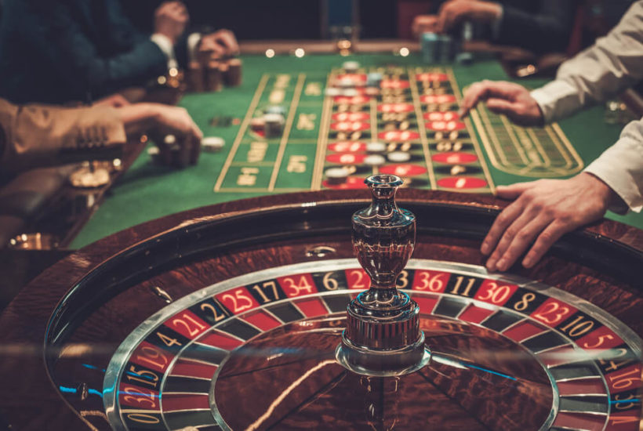
Gambling
The Indian gambling market is estimated to be worth US$60 billion per year, of which about half is illegally bet. According to the Indian National Newspaper, the Chief Executive officer for the International Cricket Council (ICC) said he was in favour of legalising betting in sports.

Slide 38
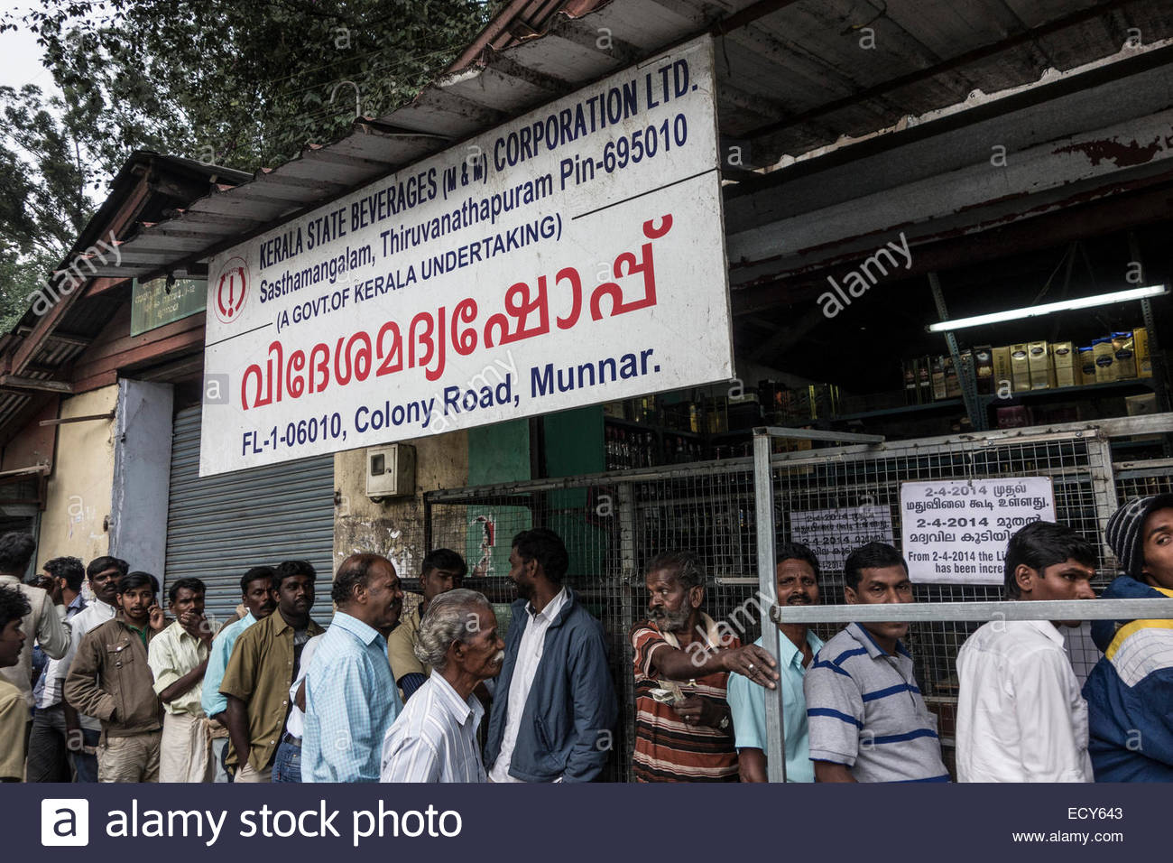
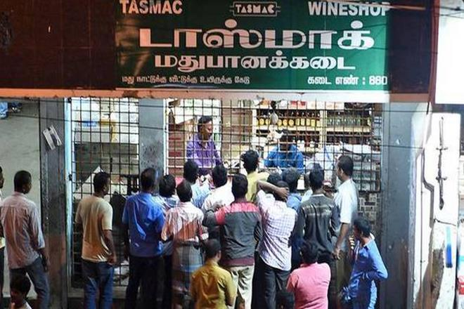
Alcohol Industry
Revenue in the Alcoholic Drinks market amounts to US$73,366m in 2019. The market is expected to grow annually by 7.6% (CAGR 2019-2021).
The influence of alcohol amongst youngsters across the five South Indian states is limited. The youth between the ages of 15 to 29 consume less alcohol compared to other age groups. At 5.5 per cent youngsters in Andhra Pradesh consume the most alcohol compared to other South Indian states.

Slide 39
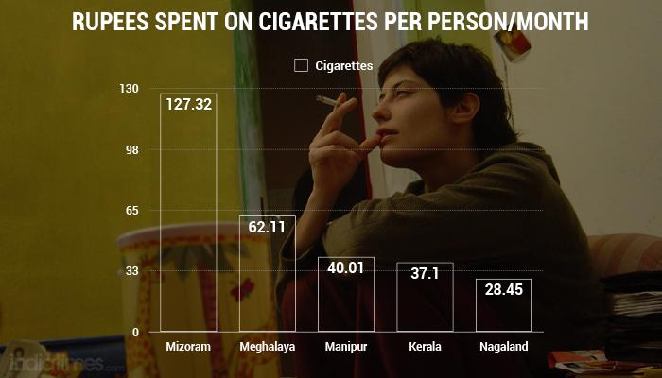
Alcohol, Cigarettes And Ganja:
Which States In India Spend The Most On Getting High
Mizoram: ...
Meghalaya: ...
Manipur: ...
Kerala: ...
Nagaland: ...
Arunachal Pradesh. ...
Sikkim. ...
Andhra Pradesh.

Slide 40
Tobacco
India is a leading tobacco exporter with exports of leaf tobacco and tobacco products generating foreign exchange earnings of around Rs. 6,000 crores annually.

Slide 41
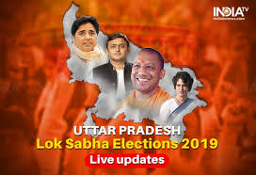
Elections
The UP polls saw a total of over Rs 5,500 crore spent on campaign by various parties, including about Rs 1,000 crore towards 'note for vote', with nearly one-third voters admitting to cash or liquor offer, a survey claimed today. The Election Commission of India allows Rs 25 lakh per candidate for campaign expenditure, but it is best known secret that most candidates spend much more than what is officially allowed and what candidates declare after the poll.

Slide 42
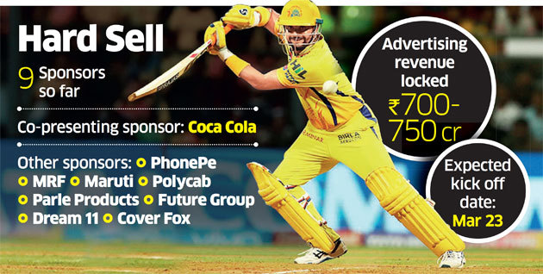
Sports
Sports sponsorship in India crossed $1 billion for the first time in 2017: Report

Slide 43
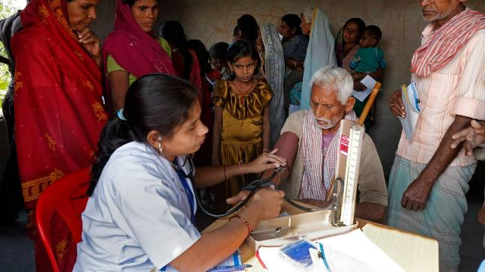
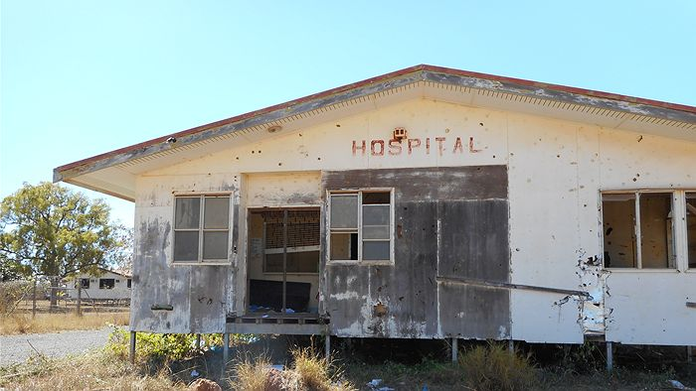
Health
Presently, the total expenditure on health is below 4 percent of the GDP while the government expenditure is below 1.3 percent of GDP. The new National Health Policy (NHP) promises to increase this to 2.5 percent by 2025.Jan 31, 2018
NEW DELHI (Reuters) - India is poised to raise its public health spending by 11 percent in the annual budget next month, after rejecting the health minister’s demand for a much bigger increase to ramp up disease control, according to government sources and documents.
U.S. health care spending grew 3.9 percent in 2017, reaching $3.5 trillion or $10,739 per person. As a share of the nation's Gross Domestic Product, health spending accounted for 17.9 percent.Dec 11, 2018

Slide 44
Conclusion
WHERE ARE WE HEADED?
……….
WHO CAN HELP?

Slide 45
